Slide 1
Explore New Heights: A Minority-Focused Guide to Aerospace Graduate School

Slide 2
Why Bother?
Career and Pay
A graduate degree will make you more competitive in the industry
Managerial roles almost always require an MS
Industry R&D positions require at least an MS, if not a PhD
Increased starting salaries ($14-$20K)
Job security
Earning a masters with research experience offers career flexibilities

Slide 3
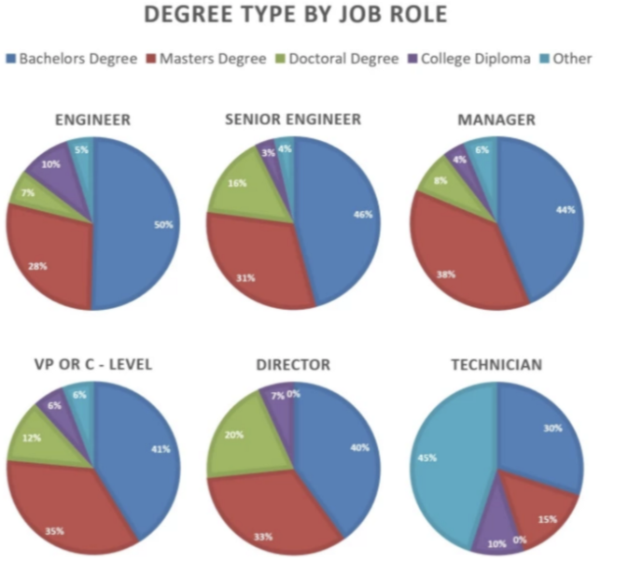
Degree Type by Job Role (Industry)
Figure courtesy of AECC Global, “Is a master’s degree in engineering worth it?”

Slide 4
A Career in Research
Academic, higher ed teaching, and technical research institution positions require a PhD
Degree process is ‘job training’
Important to choose a field that resonates with you
Focus is on achieving strong technical specialization vs broad professional skillset
Direct PhD can be completed in ~4 years
Very common to earn a masters first or on the way to feel it out

Slide 5
What is your life like?
Grad School is a full-time job (40hrs)
Typical Grad-Student Semester
2-3 four-credit hour classes
Mix of 400- and 500-level
Research expectations
Weekly advisor and group meetings
20hrs of week (+/-)
Time off
Appointments by Semester
Summer Appointments

Slide 6
What is your life like?
Advisor Relationship
You should want to work with you advisor, and they should want to work with you
Mutual respect
Advocate for yourself and your work
Your time and effort has value!
Work/Life Balance
Have dedicated “Me-Time”
Take breaks
Socialize

Slide 7
What is your life like?
Free Time
Evenings and Weekends can be yours!
Restaurants and Bars in Champagne/Urbana
Local Hiking etc.
Community Support
Fellow Grad-Students are in it with you
Course recommendations, quals guidance, friendship and understanding

Slide 8
Disability Resources & Educational Services (DRES)
Provides resources and accommodations to make sure you:
Succeed academically
Feel supported
Offer neuropsychological testing to students who believe they may have a disability that is undiagnosed
For a full list of the support they offer and resources they have, please reference their website
https://www.disability.illinois.edu/

Slide 9
Student Legal Services
Offer students access to legal counsel for a variety of issues
See their website for a full list of resources. To name a few:
Traffic court
Notary Services
Rental Issues
https://odos.illinois.edu/sls/

Slide 10
Illinois Off-Campus Community Living
University resource that provides housing advice and guidance
Can connect you with resources related to housing issues
Collect complaints (w/in last 5 yrs) against landlords to help you make a decision regarding housing
https://occl.illinois.edu/

Slide 11
Student Assistance Center
Catch-all for help! Reasons to contact them include:
Academic difficulty due to physical or mental health issues
To report a concern about the well-being or safety of themselves, another student, or the broader community
Difficulty with a professor or TA
Not sure where else to go
For example: connecting a student experiencing discrimination based on sex to UIUC's Title IX office

Slide 12
Administrative Efforts
Office of the Provost
Office of Vice-Chancellor for Diversity, Equity, and Inclusion
Both contain diversity-focused committees, such as:
Gender Equity Council (GEC)
Committee on Race and Ethnicity (CORE)
LGBTQ Concerns Committee
Provide policy advice, create programs for students/faculty

Slide 13
Support Organizations
Minorities in Aerospace (MAero)
Out in STEM (oSTEM)(LGBTQ+)
Society of Hispanic Professional Engineers (SHPE)
National Society of Black Engineers (NSBE)
Society for the Advancement of Chicanos and Native Americans in Science (SACNAS)
Society of Women Engineers (SWE), Women in Aerospace (WIA), and Women in Engineering (WIE)
http://www.ec.illinois.edu/affiliated-societies

Slide 14
Types of Funding
Appointments
Fellowships and Scholarships
External
Internal
Corporate Sponsorship
https://grad.illinois.edu/

Slide 15
Appointments
Teaching or research assistantships
Provided for work done for the school/department
Can generate waivers for tuition and fees
Have a rate dependent on the time expected
Common for graduate students doing research
Will be outlined in your offer letter
Reach out to department for information regarding the specifics
Grainger College of Engineering guarantees funding for first 5 years of PhD (https://grainger.illinois.edu/academics/graduate/phd-funding-guarantee)
Don’t self-fund a PhD

Slide 16
Fellowships and Scholarships: General
Full and partial funding opportunities
Partial: may pay an additional stipend or help with cost of attendance
Full: pays total cost of attendance and can include cost of attendance
Duration dependent
Total number of years often limited
Many require annual reviews or reapplication to ensure satisfactory progress
Some may adjust their rewards annually
When to apply
Some require you to be at a certain point in your degree

Slide 17
Fellowships and Scholarships
Internal
External
Administered by the department or college
Can be found on college or department website
Method of consideration
Direct application
Nomination required
Ex. Graduate Assistance in Areas of National Need
Typically administered by:
Government organizations
Foundations or professional organizations
May carry internship placements/professional development opportunities

Slide 18
External Fellowships and Scholarships
Government
Foundations and Professional Organizations
Focus areas include:
National defense (DOD)
Fundamental research (NASA, NSF)
Many are shaped by government priorities/focus areas
Ex. NASA Space Technology Graduate Research Opportunities
Wide variety of targeted fellowships focused on factors such as:
Field
Minority/underrepresented student status
Socioeconomic background
Career goals
Ex. Ford Fellowship

Slide 19
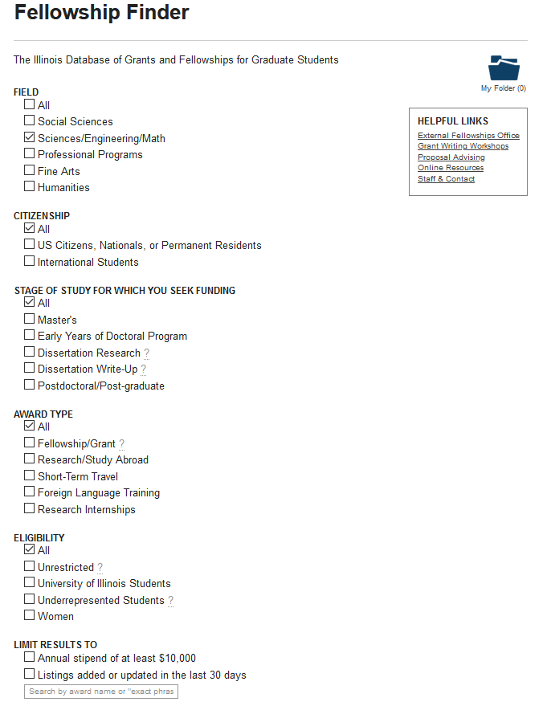
Finding Fellowships
Start with UofI fellowship finder
Easy UI enables filtering for relevant content
https://apps.grad.illinois.edu/fellowship-finder/

Slide 20
Finding Fellowships (Continued)
Talk to your advisor
May have experience getting specific fellowships
Can recommend fellowships to you based on research and career goals
Look at professional organizations
Groups that advocate for specific demographics often advertise ones directed at their members
Government fellowships often advertised by agencies website
NASA has NSPIRES and many other agencies have fellowship listings on their websites

Slide 21
Considerations About Fellowships
Can offer more research freedom
Some independent of specific project
Can have different tax considerations
Some fellowships don’t withhold tax
Know your tax responsibilities
Can carry additional prestige/opportunities

Slide 22
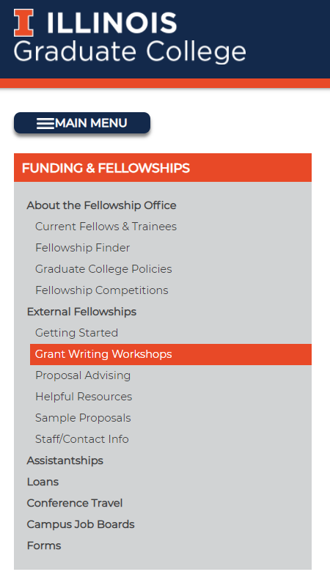
Common Items for Fellowships
Transcript
Statement of purpose
Statement of goals/career objectives
Research interests/plans
Graduate College offers many resources
https://grad.illinois.edu/fellowships/about

Slide 23
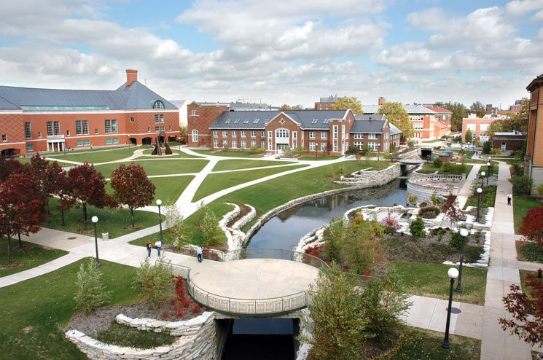
Corporate Sponsorship
Some companies will fund employee’s advanced degrees
Typically requires spending time at a company first
Often focused on Master’s degrees

Slide 24
Where to Start
Consider diversity initiatives and healthy atmosphere when selecting schools
Applications are usually due at the beginning of November; check to be sure!
Consider applying to fellowships; again, reach out to application mentoring resources!

Slide 25
https://gsac.ae.illinois.edu/

Slide 26
Q & A
Feel free to ask questions!
Slides posted at https://gsac.ae.illinois.edu/

