Slide 1
Welcome to UIUC!

Slide 2
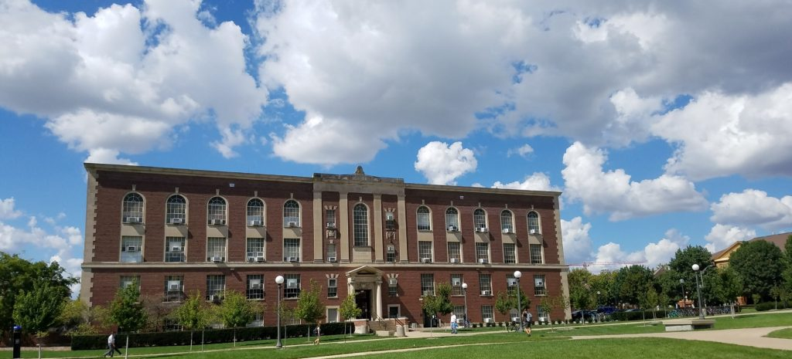
Talbot Laboratory
Built in 1928 (old building, but lots of new additions)
Also houses NPRE (Nuclear, Plasma, Radiological Engineering)
Located at 104, S Wright Street, Champaign.

Slide 3
What is your life like?
Grad School is a full-time job (40hrs)
Typical Grad-Student Semester
2-3 four-credit hour classes
Mix of 400- and 500-level
Research expectations
Weekly advisor and group meetings
20hrs of week (+/-)
Work/Life Balance
Time off
Appointments by Semester
Summer Appointments

Slide 4
Course Requirements
Total credit hours:
International: 12 credit hours
Domestic: 8-9 credit hours
500 and AE requirements
Breadth requirements
Math requirement
Seminar (every semester, unless you’re a PhD past quals)
TA requirement for PhD
For thesis students, use thesis credit to stay above full-time
“Good standing” requirement- above 3.0 GPA

Slide 5
Illinois Off-Campus Community Living
University resource that provides housing advice and guidance
Can connect you with resources related to housing issues
Collect complaints (w/in last 5 yrs) against landlords to help you make a decision regarding housing
https://occl.illinois.edu/

Slide 6
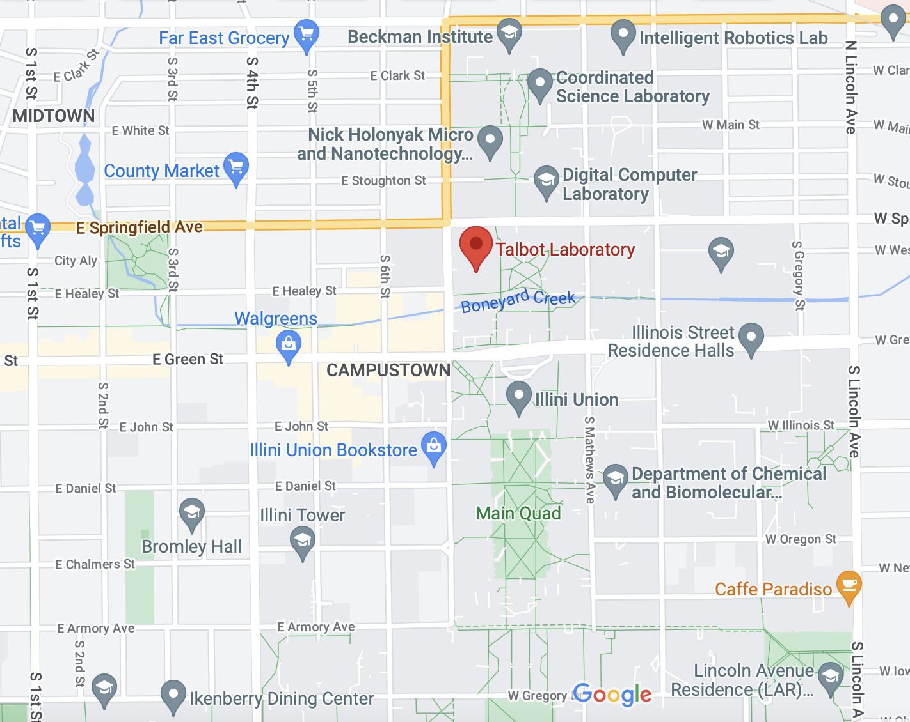

Slide 7
On-Campus Resources
Disability Resources & Educational Services (DRES)
Provides resources and accommodations to succeed academically & feel supported.
https://www.disability.illinois.edu/
Student Legal Services
Offer students access to legal counsel for a variety of issues
https://odos.illinois.edu/sls/
Student Assistance Center
Academic difficulty due to physical or mental health issues.
To report a concern about the well-being or safety of themselves, another student, or the broader community.
Not sure where else to go

Slide 8
Support Organizations
Minorities in Aerospace (MAero)
Out in STEM (oSTEM)(LGBTQ+)
Society of Hispanic Professional Engineers (SHPE)
National Society of Black Engineers (NSBE)
Society for the Advancement of Chicanos and Native Americans in Science (SACNAS)
Society of Women Engineers (SWE), Women in Aerospace (WIA), and Women in Engineering (WIE)
http://www.ec.illinois.edu/affiliated-societies

Slide 9
Types of Funding
Appointments
Fellowships and Scholarships
External
Internal
Corporate Sponsorship
https://grad.illinois.edu/
On-Campus jobs
Do not include tuition waiver.
Hourly paid job
Virtual Job Board
https://secure.osfa.illinois.edu/vjb/

Slide 10
Appointments
Teaching or research assistantships.
Provided for work done for the school/department.
Generate waivers for tuition and fees
Have a rate dependent on the time expected
Common for graduate students doing research.
Will be outlined in your offer letter
Reach out to department for information regarding the specifics
Grainger College of Engineering guarantees funding for first 5 years of PhD (https://grainger.illinois.edu/academics/graduate/phd-funding-guarantee)
Don’t self-fund a PhD

Slide 11
Fellowships and Scholarships: General
Full and partial funding opportunities
Partial: may pay an additional stipend or help with cost of attendance.
Full: pays total cost of attendance.
Duration dependent
Total number of years often limited
Many require annual reviews or reapplication to ensure satisfactory progress
Some may adjust their rewards annually
When to apply
Some require you to be at a certain point in your degree

Slide 12
Fellowships and Scholarships
Internal
External
Administered by the department or college
Can be found on college or department website
Method of consideration
Direct application
Nomination required
Ex. Graduate Assistance in Areas of National Need
Typically administered by:
Government organizations
Foundations or professional organizations
May carry internship placements/professional development opportunities

Slide 13
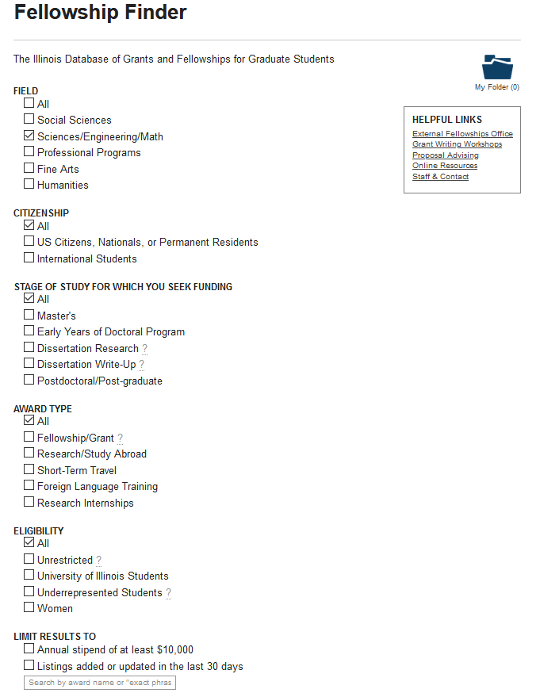
Finding Fellowships
Start with U of I fellowship finder
Easy UI enables filtering for relevant content
https://apps.grad.illinois.edu/fellowship-finder/

Slide 14
Finding Fellowships (Continued)
Talk to your advisor
May have experience getting specific fellowships.
Can recommend fellowships to you based on research and career goals.
Look at professional organizations
Groups that advocate for specific demographics often advertise ones directed at their members.
Government fellowships often advertised by agencies website
NASA has NSPIRES and many other agencies have fellowship listings on their websites.

Slide 15
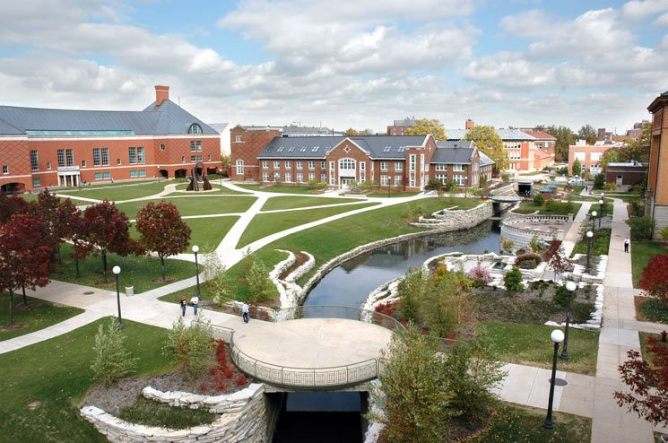
Corporate Sponsorship
Some companies will fund employee’s advanced degrees
Typically requires spending time at a company first
Often focused on Master’s degrees

Slide 16
https://gsac.ae.illinois.edu/

Slide 17
Q & A
Feel free to ask questions!
Slides posted at
https://gsac.ae.illinois.edu/

